Slide 1

JAVA, JEE Training – java.io
Harinath Mallepally
harinath@careerscale.in
Notes:
IMPORTANT – PLEASE READ.
Use this template to create your online courses. Change the template as you see fit, including the logo, images and copyright information. Add your speaker's notes to the Notes section of the PowerPoint (e.g. THIS SECTION) and then submit it to Dual Code's PowerFlash service.
Your PowerPoint will be converted to a Flash-based eLearning module or presentation. A professional voice-over artist will read you speaker’s notes and incorporate the resulting audio files in the Flash course. You will also have the option to save the course to a standard (Flash + HTML) format or SCORM compliant package so you can deploy it in your Learning Management System of choice.
Try it for FREE. Visit http://www.dualcode.com/elearning/powerflash.htm for more details.

Slide 2


Java IO introduction
To bring in information, a program opens a stream on an information source (a file, memory, a socket) and reads the information sequentially, as shown in the following figure.
Reading information into a program.
Writing information out of a program
Reading and Writing Algorithm for Data
Reading | Writing
open a stream while more information read information close the stream | open a stream while more information write information close the stream

Slide 3
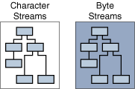
Java IO classification
Java organizes the IO API into 2 different classes.
Byte streams
Character data

Slide 4
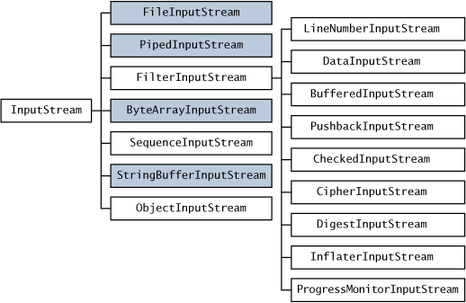
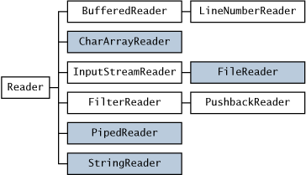
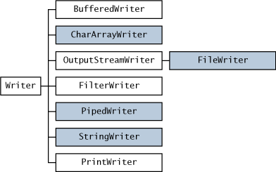
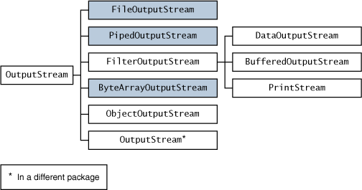
Java IO classes

Slide 5
Java IO – Streams hierarchy

Slide 7
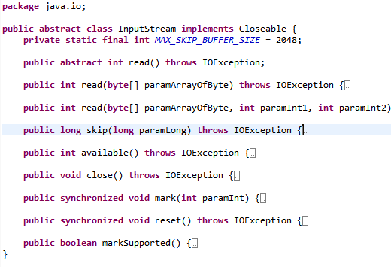
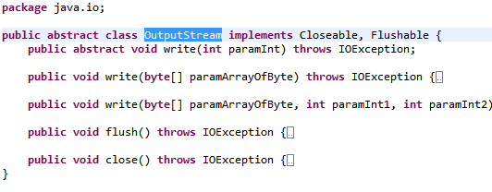
Java IO – InputStream,OutputStream

Slide 8
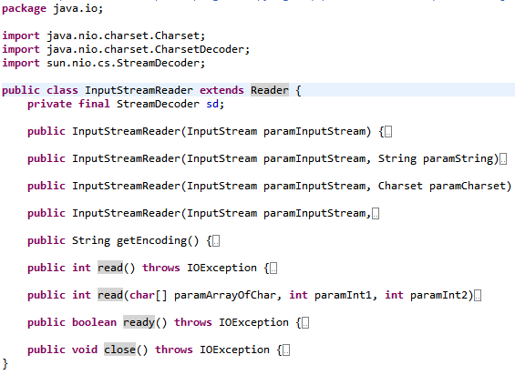

Slide 9
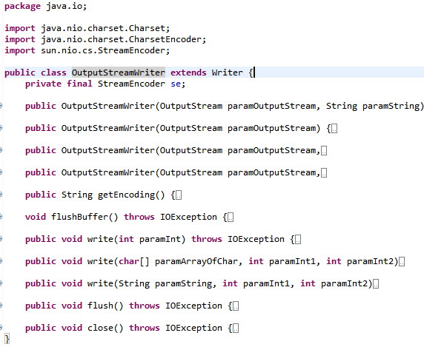

Slide 10
Java IO – Sample code in eclipse
Please follow the live class

Slide 11

Questions?
Let us begin!

